Slide 1
Big Data Final Project Topic : QA system on movies dataset
Group member:
Dharmik Rajesh Kurlawala – 2886995
Niteesh Nitin Singh – 2886321
adviser:
Dr. Sunnie Chung

Slide 2
Goal:
Building a Robust Movie QA System.
Using Natural Language Processing (NLP) and NEO4J Graph Database
Key Achievements:
Data Collection and Preparation
Triples Extraction with NLP
Entity-Relation Mapping
Knowledge Graph Construction
Query Parsing (Natural Language)
Cypher Query Generation
Graph Query Execution

Slide 3


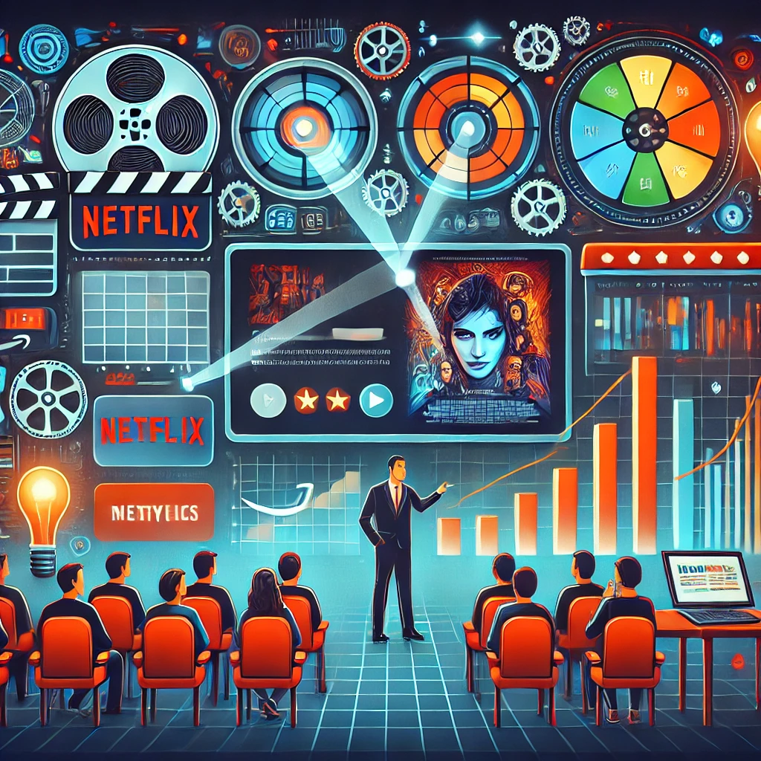
Real-World Applications of the Movie QA System:
Streaming Platforms: Enhance user experience with real-time movie-related query handling.
Entertainment Analytics: Provide insights on trends in movies, genres, and actors.
Educational Tools: Assist film studies students and researchers with quick access to movie details.
Market Analysis: Support production houses in analyzing audience preferences.

Slide 4
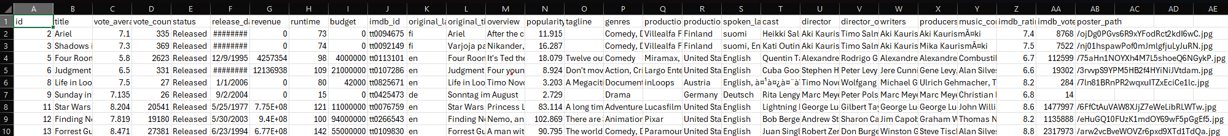
Data Description, Data Size, Data Collection Method:
We used Kaggle website to download movie dataset. The raw data contains 1 million movie details in it. (link to dataset).
The TMDB (The Movie Database) is a comprehensive movie database that provides information about movies, including details like titles, ratings, release dates, revenue, genres, and much more.
We have filtered down the data and used last 5 years movie details starting from 1/1/2020, which is more than ~200K Movies data.
Although we plan to extend our project and use entire 1M dataset.
The data was downloaded in the form of CSV file.

Slide 5
Platform Setting/System Configuration Procedures:
MongoDB community version:
connect to MongoDB (mongodb://localhost:27017/).
The connection were made via python code.
Neo4j desktop:
Setup the DBMS with name and password.
Made few config changes:
dbms.memory.heap.initial_size=6G
dbms.memory.heap.max_size=6G
dbms.memory.pagecache.size=8G
dbms.windows_service_name=neo4j-relate-dbms-a4ee4310-4e49-49e0-9082-926af4973254

Slide 6
System Design (Architecture):
Neo4j Graph Database
QA System
QUESTION PARSER
Parse Question
NODES
Intent & Entities
User Question
Movie
Person
Genre
Language
Country
Company
Entity(object/subject)
Application Server
Generated Query
QUERY GENERATOR
Intent & Entities
Query Result
Generated Response
Answer
RELATIONSHIPS
Neo4j-Admin Import
ER Mapping & CSV Export
Movies & Triples
BELONGS_TO_GENRE
SPOKEN_IN
PRODUCTION_COMPANY
PRODUCED_IN
ACTED_IN
DIRECTED_BY
WRITTEN_BY
PRODUCED_BY
COMPOSED_BY
DOP_BY
Triples Relation
MongoDB
Cleaned Movie Data
MOVIES COLLECTION
Cleaned Data
Data Cleaning
Raw Data
TMDB Movies
Dataset
NLP Triples Extraction
Extracted Triples
TRIPLES COLLECTION

Slide 7
Data cleaning:
Purpose: Ensure consistency and error-free data for downstream processing..
Key Steps:
Removed rows with missing critical fields (e.g., title).
Replaced invalid/zero values with NA in numeric fields.
Standardized and normalized text fields.
Ensured consistency in date format.
Split multi-valued fields into lists, for relational mapping.
Removed duplicate records.
Finally saved cleaned data in MongoDB.

Slide 8
Required Libraries:
For NLP:
spaCy, stanza, CoreNLPClient, urllib3, coreferences
For MongoDB:
MongoClient
For Neo4j:
GraphDatabase
For Web Application:
Flask, request, render_template

Slide 9
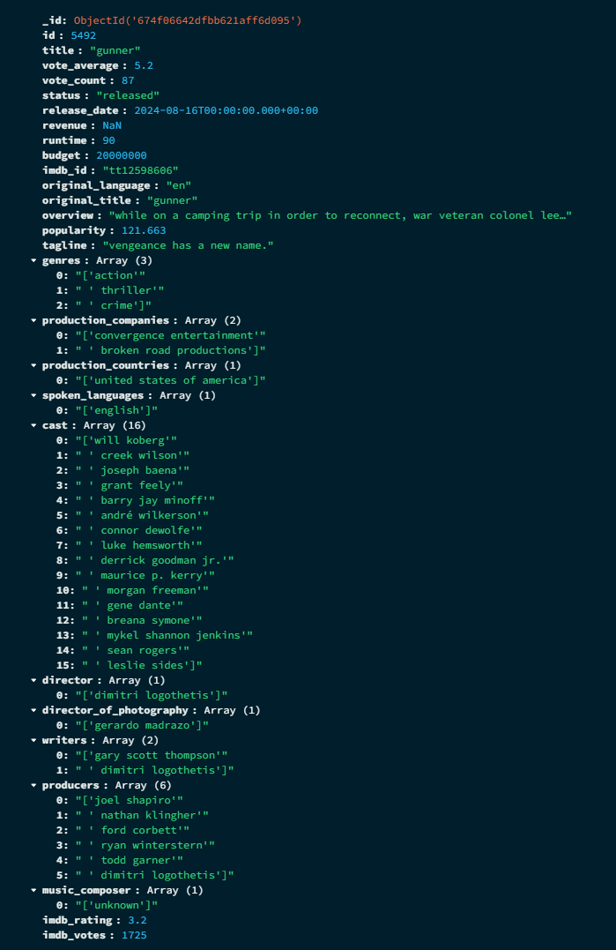
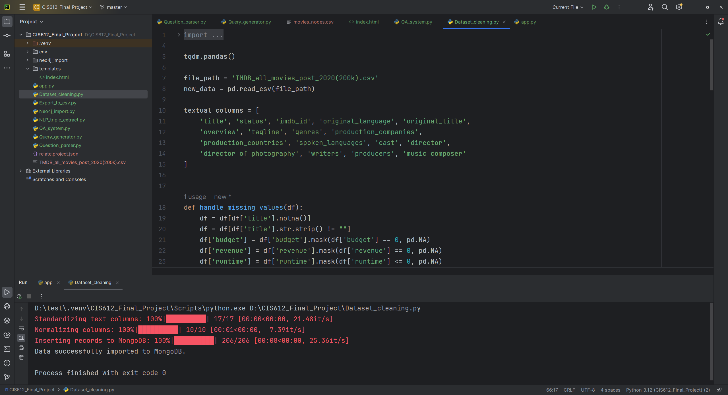
Cleaned MongoDB Data:
Intermediate Output:

Slide 10
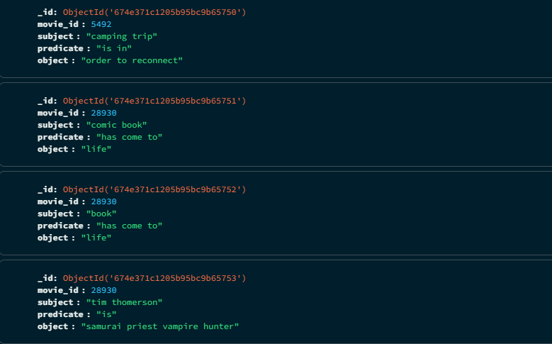
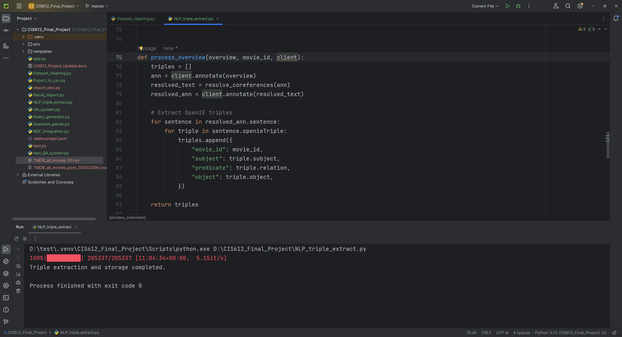
NLP-Based Triple Extraction:
We used libraries like – Stanza, Stanford CoreNLP, coreferences to process movie overviews for natural language understanding.
Our NLP pipeline involve POS, NER and finally used Stanford CoreNLP for triples generation.
Extracts subject-predicate-object triples to represent semantic relationships.
Stores the extracted triples in MongoDB for integration into the knowledge graph.

Slide 11
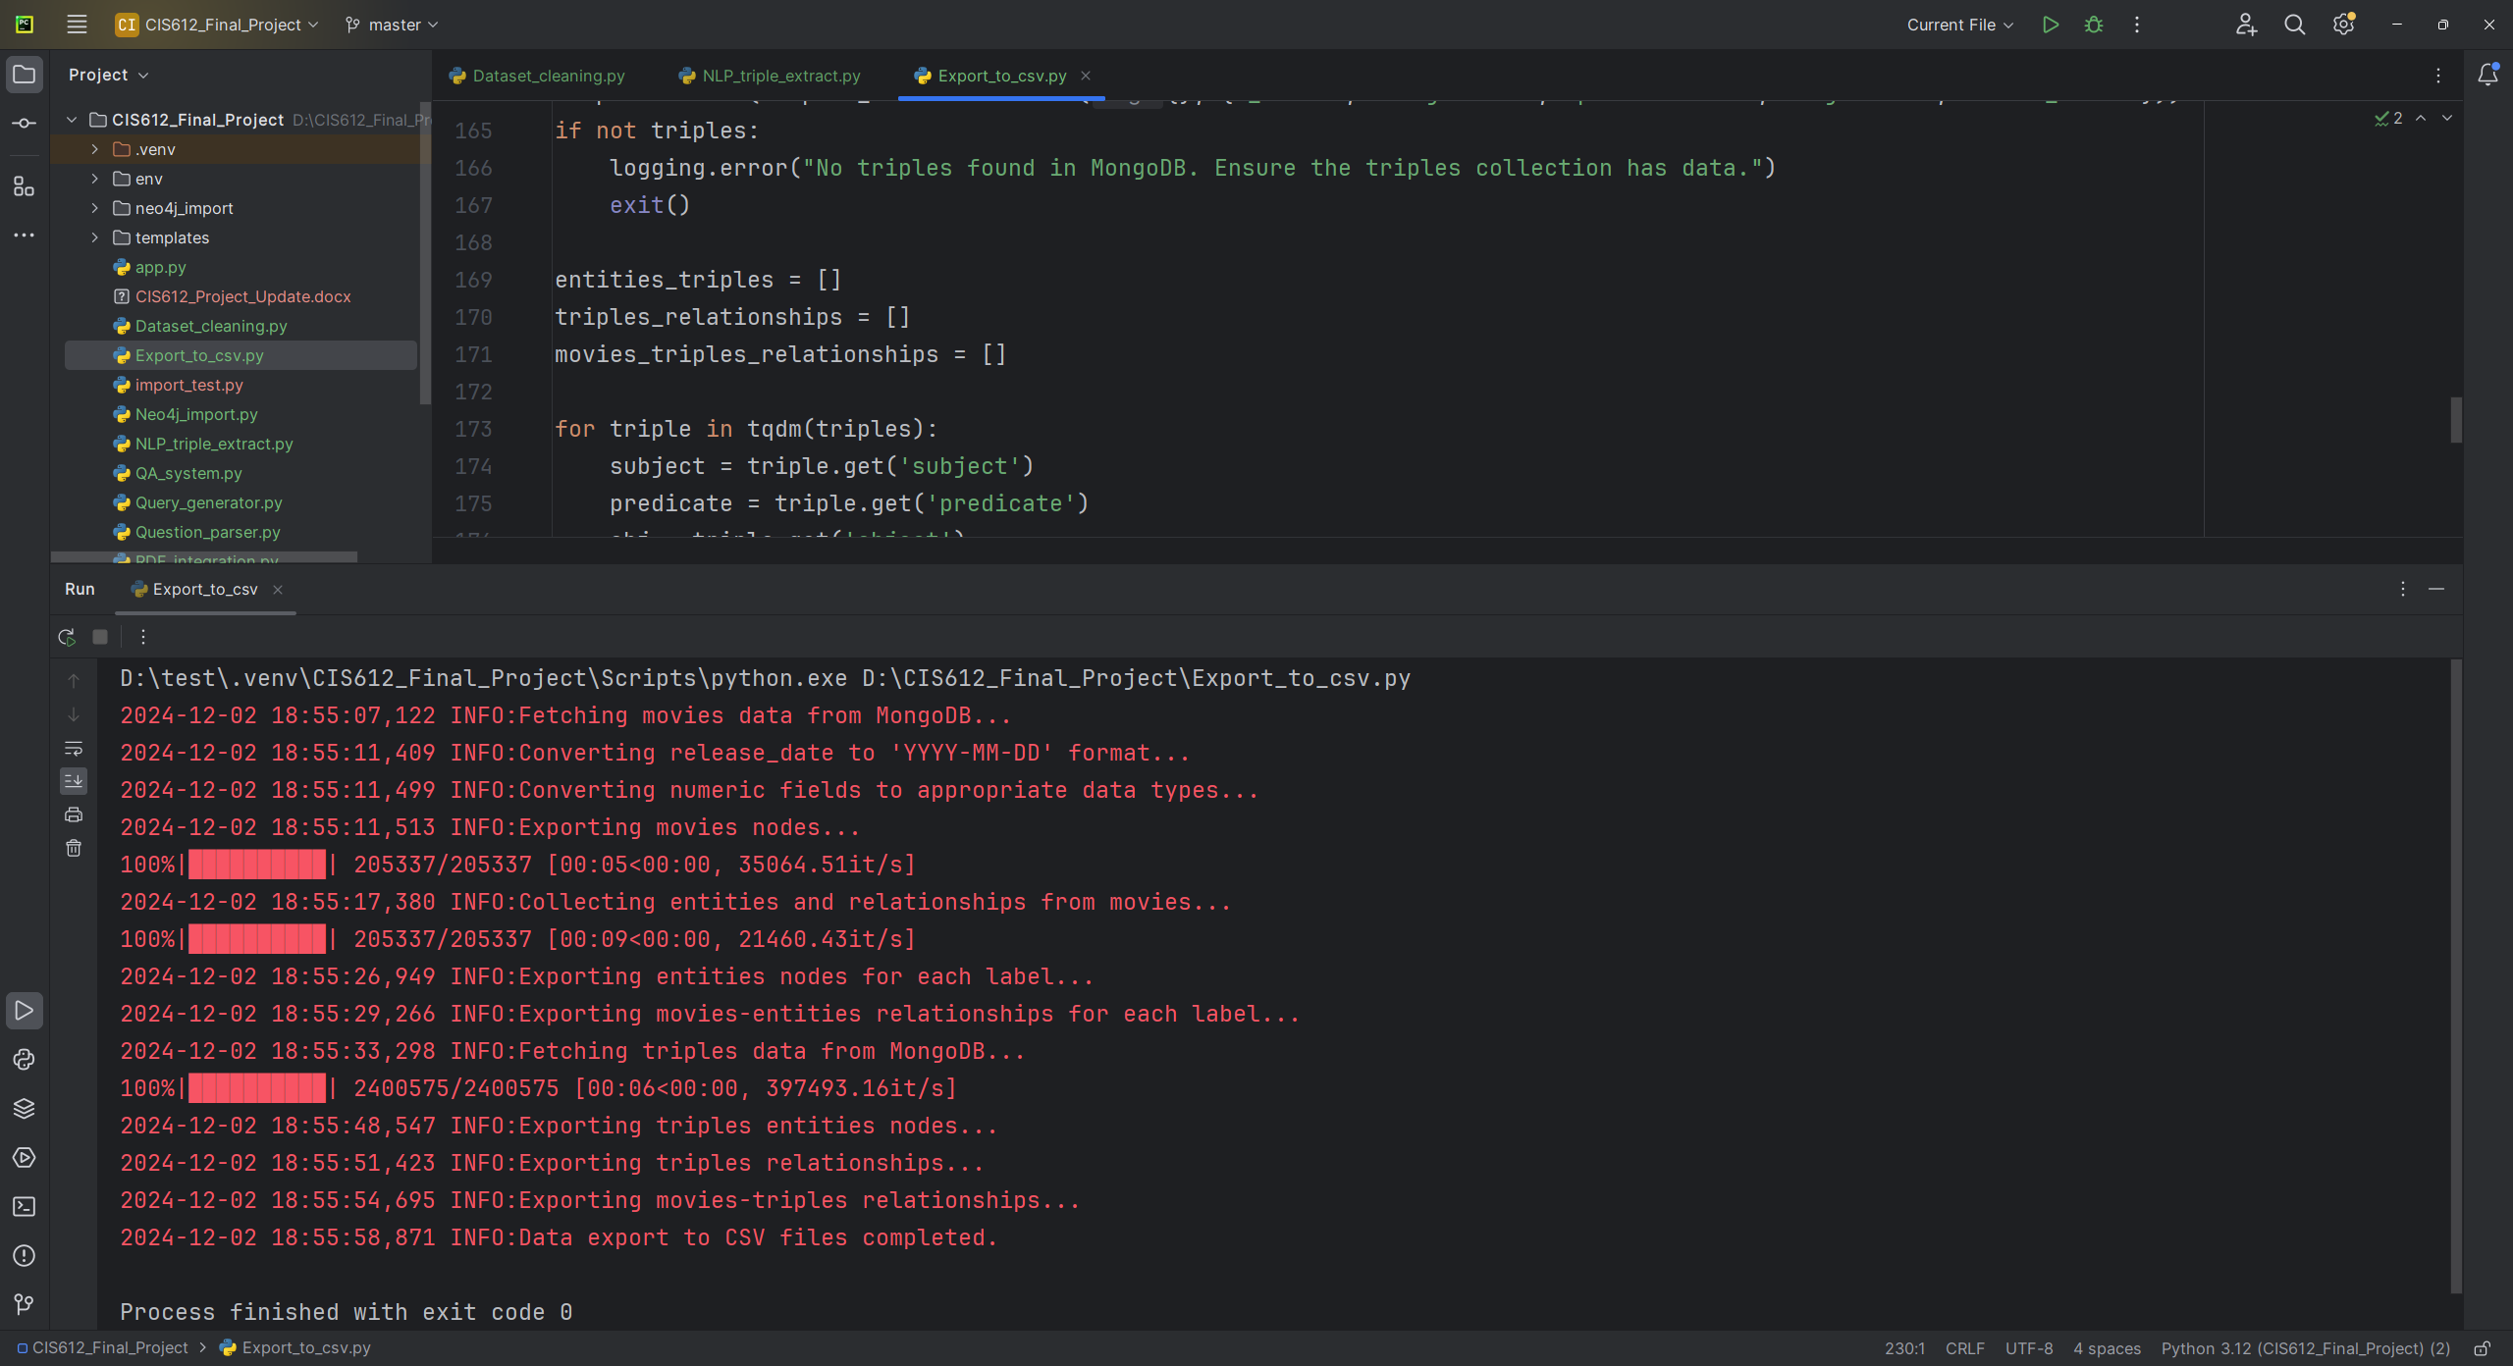
CSV Data Preparation for Neo4j Admin Import:
ER mapping & CSV export Code:
CSV files generated:
Entities nodes
Movies entities relations
Movies nodes
Movies triples relations
Triples entities nodes
Triple relations

Slide 12
What is Neo4j and Why Use It?
Overview:
Neo4j is a graph database management system designed to model data as connected entities (nodes) and their relationships.
Key Benefits:
Optimized for Relationships: Efficiently stores and retrieves complex connections (e.g., finding movies by director or cast).
Scalability: Maintains high performance for large datasets, avoiding the limitations of relational databases with multiple joins.
Flexibility: Schema-free design supports diverse data types (e.g., movies, genres, people).
Advanced Querying: Executes complex graph traversal queries (e.g., identifying revenue-based genre trends).

Slide 13
Problem Faced While Importing MongoDB Data into Neo4j:
Challenges:
Importing a large dataset (~2.2M nodes, ~7.8M relationships, ~211K relationship types) caused bottlenecks.
Using Python Driver Import was not feasible due to prolonged import times and performance issues (e.g., bottlenecking).
Solutions Considered:
Python Driver Import:
Suitable for small datasets but inefficient for large-scale imports.
Neo4j Admin Import:
Selected as the solution due to its ability to import large datasets in under a minute. Effectively handled the scale and complexity of the data.

Slide 14
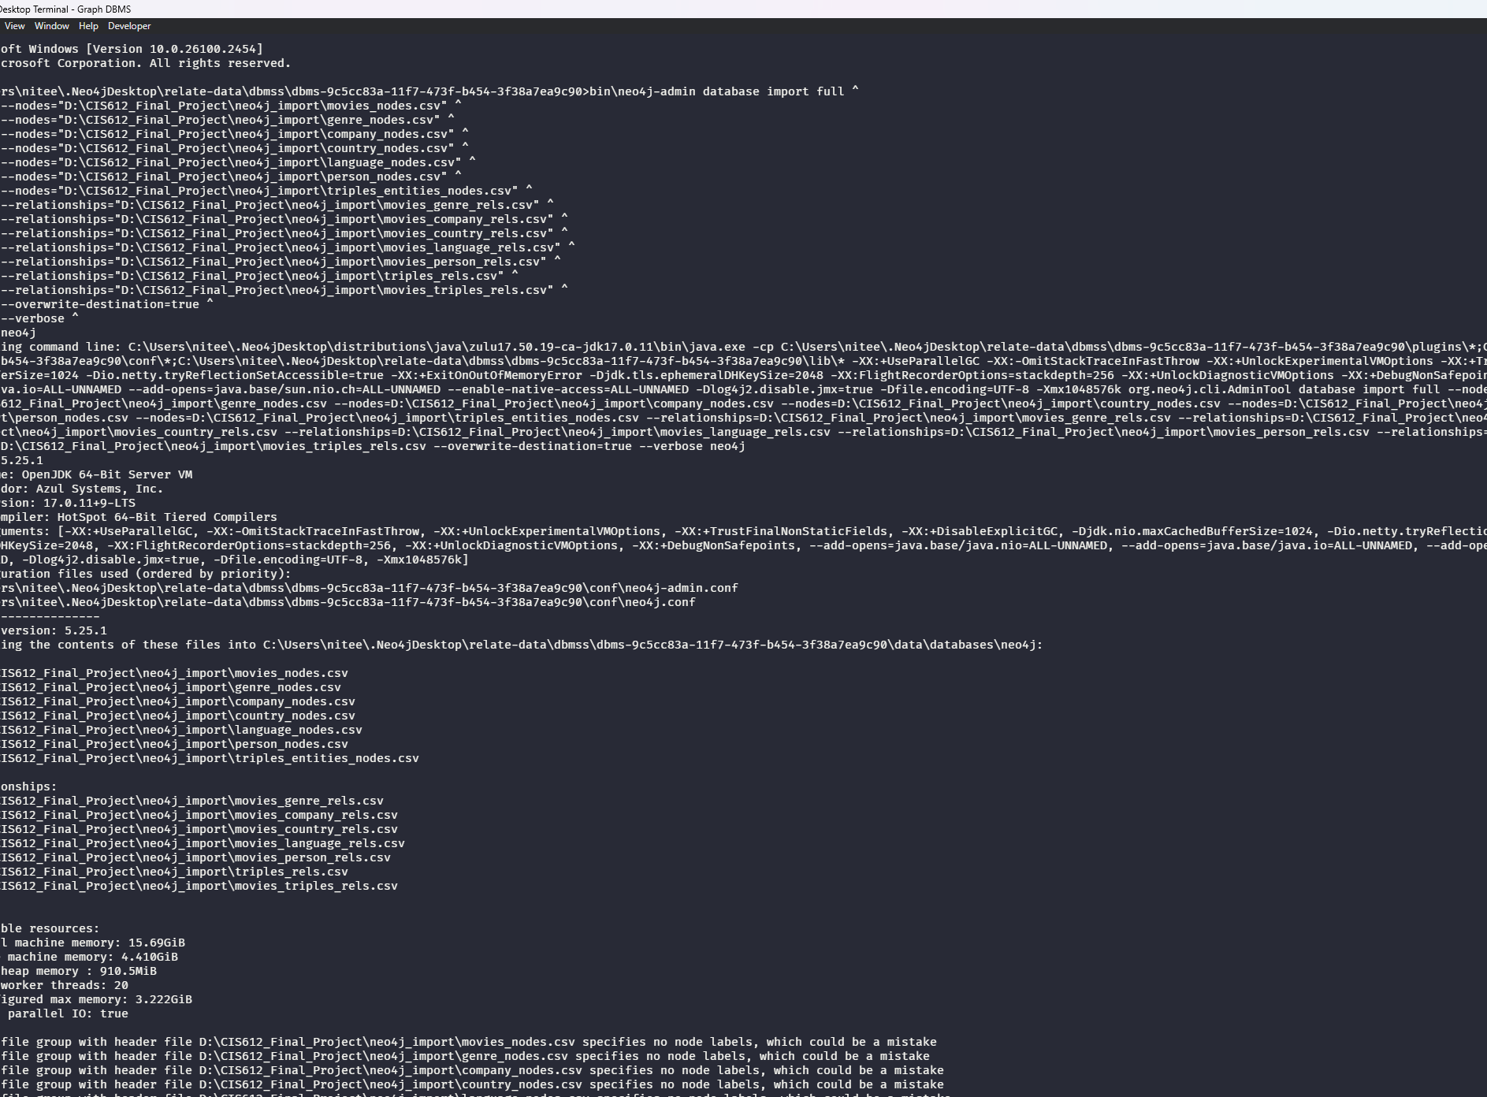
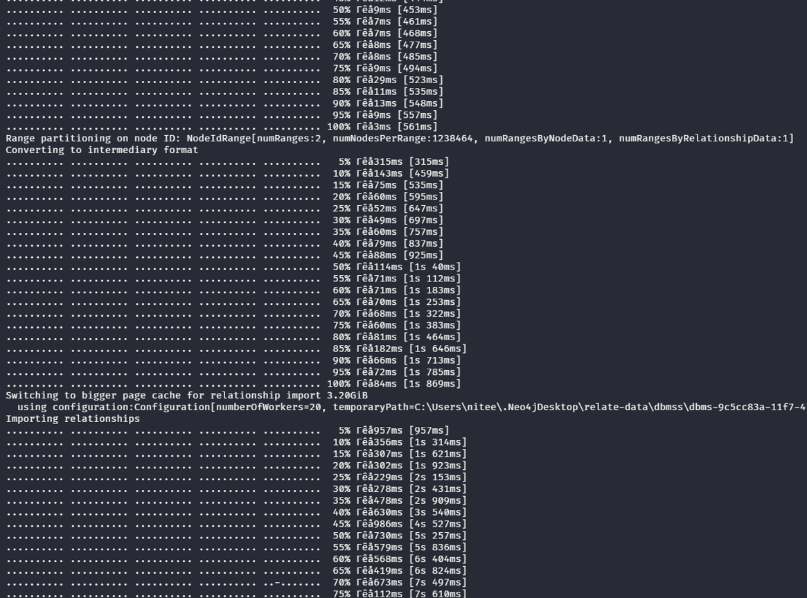
Neo4j Admin Bulk Import:
bin\neo4j-admin database import full ^
--nodes="D:\CIS612_Final_Project\neo4j_import\movies_nodes.csv" ^
--nodes="D:\CIS612_Final_Project\neo4j_import\entities_nodes.csv" ^
--nodes="D:\CIS612_Final_Project\neo4j_import\triples_entities_nodes.csv" ^
--relationships="D:\CIS612_Final_Project\neo4j_import\movies_entities_rels.csv" ^
--relationships="D:\CIS612_Final_Project\neo4j_import\triples_rels.csv" ^
--relationships="D:\CIS612_Final_Project\neo4j_import\movies_triples_rels.csv" ^
--overwrite-destination=true ^
--verbose ^
neo4j

Slide 15
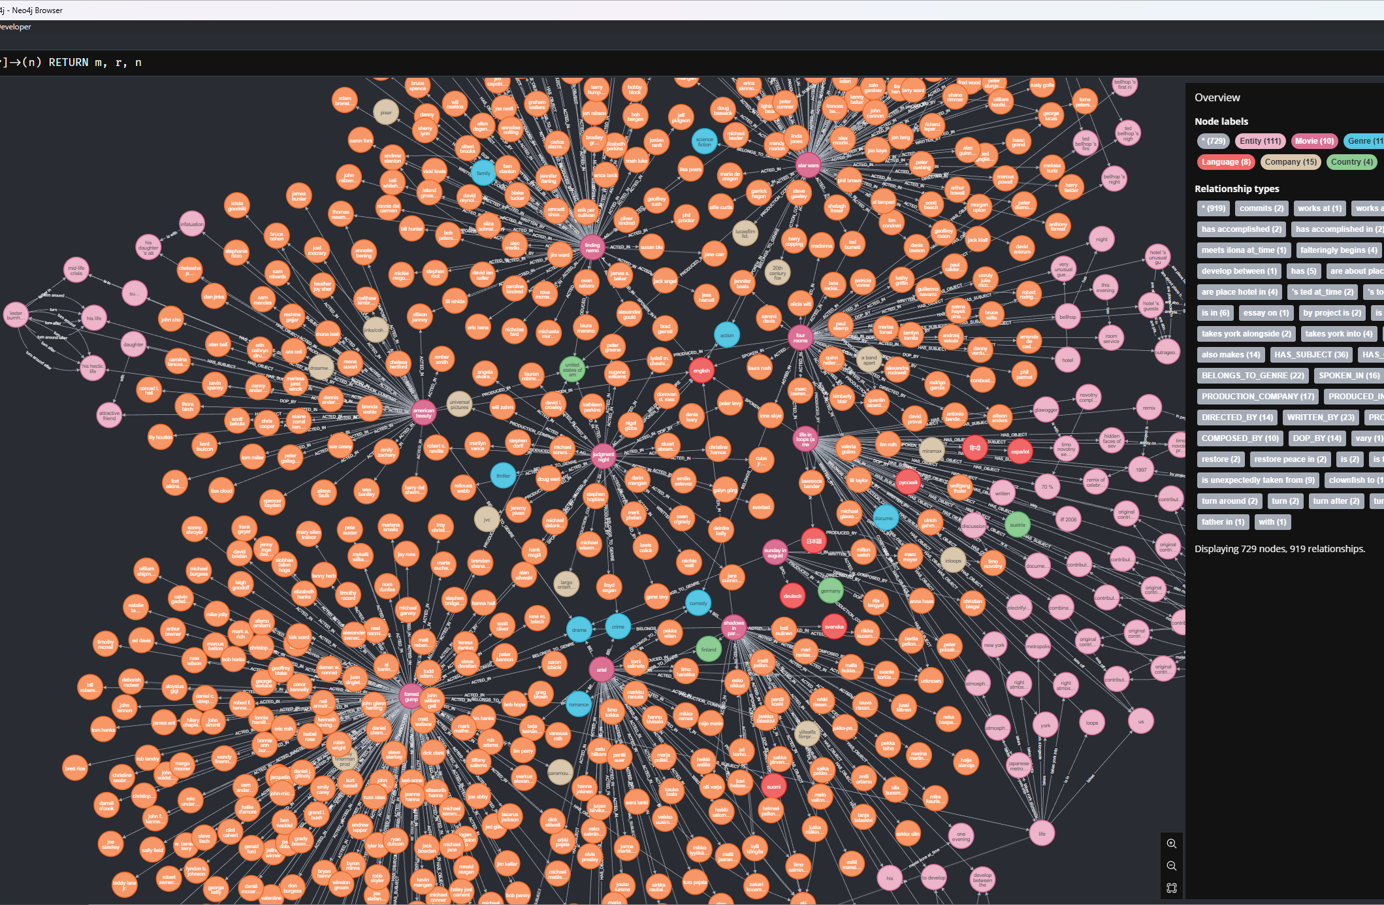
Neo4J GRAPH visualization:
Graph Visualization Issue:
The dataset includes more than 200K movies, but the slide visualizes only 10 movies due to Neo4j's limitation in rendering the full graph.

Slide 16
Contents in neo4J:
Nodes:
Movies:
Properties: Title, Release Date, Budget, Runtime, Vote Average, Language, Revenue, etc.
Person: (Actors, Directors, Writers, Producers, Music Composers, Directors of Photography (DOP))
Genre: (e.g., Action, Comedy)
Language: (e.g., English, Spanish)
Company: (e.g., Warner Bros.)
Country: (e.g., USA, UK)
Relationships:
Pre-defined such as:
BELONGS_TO_GENRE (Movie → Genre)
SPOKEN_IN (Movie → Language)
PRODUCTION_COMPANY (Movie → Company)
PRODUCED_IN (Movie → Country)
ACTED_IN, DIRECTED_BY, WRITTEN_BY, PRODUCED_BY, COMPOSED_BY, DOP_BY (Person ↔ Movie)
NLP-Extracted:
Semantic triples (Subject-Predicate-Object) such as:
HAS_SUBJECT (Movie → Subject)
HAS_OBJECT (Movie → Object)

Slide 17
Problem Faced While Building the QA System:
Initial Plan:
We planned to use Neosemantics (n10s) to build the QA system using SPARQL, which would enable semantic queries on RDF data.
Issue Encountered:
The newer version of Neo4j no longer supports Neosemantics, limiting our ability to integrate RDF data and execute SPARQL queries.
Solution Implemented:
Adapted the system to use Cypher Queries, leveraging Neo4j’s native query language to design the Q&A functionality.
Focused on efficiently querying the graph database while ensuring semantic relationships were maintained.

Slide 18
Predefined Cypher Queries for QA System
Overview:
Developed predefined Cypher queries to execute when a user's question matches a specific intent pattern.
This approach integrates data preprocessing, NLP, graph database design, and real-time query execution to meet the application's objectives.
Capabilities:
Enables answering analytical and predefined questions seamlessly.
Examples of Questions Answered by the QA System:
Direct questions:
Who directed Inception?
Which movies belong to the Action genre?
What languages does Parasite have?
Who are the actors in The Godfather?
Which company produced Titanic?
What is the revenue of Avatar?
Give all details of Interstellar.
Analytical questions :
What are the top 20 movies in each genre?
Who are the top 5 most successful actors?
Which genres were most successful in 2020?
Who are the top 5 most successful directors by average movie rating?
Which production companies have the most successful movies?
What is the yearly box office trend?

Slide 19
Building Question answer system:
Objective:
To understand and process user queries before generating responses in the QA system.
Process:
Parse the user's question to identify intent, pattern, and entities.
Convert the parsed input into a Cypher query for execution.
Example:
Input Question: "Who is the director of Movie X?“
Parsed Intent:
Generated Cypher Query:
'intent': 'FindDirector', 'pattern': r'who\s+(directed|is the director of)\s+(?P<Movie>.+)', 'entities': ['Movie']
MATCH (m:Movie)<-[:DIRECTED_BY]->(d:Person) WHERE toLower(m.title) = toLower($movie_title) RETURN d.name AS director

Slide 20
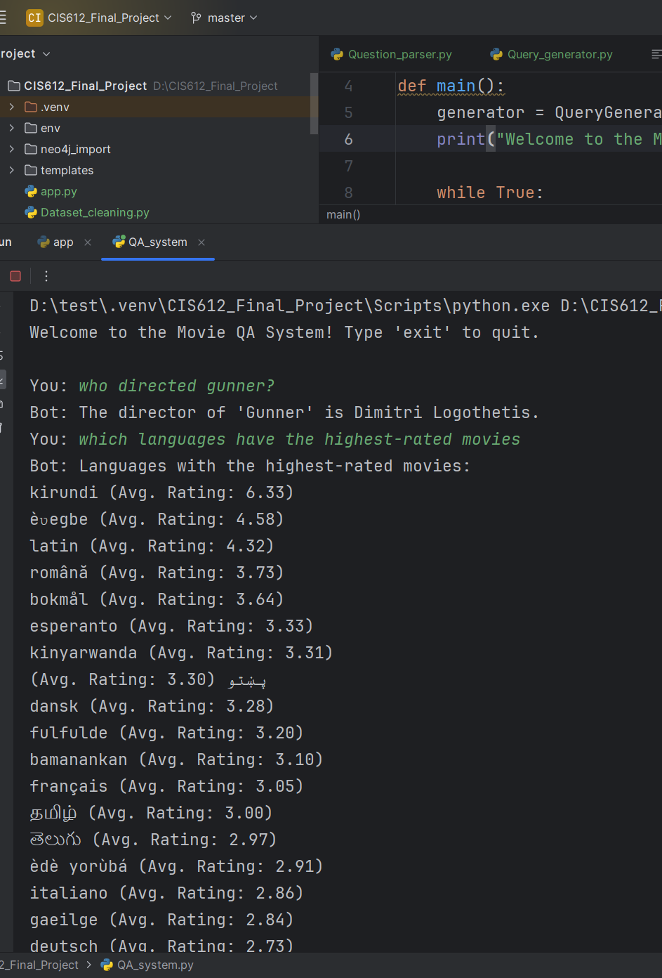
Testing QA system on console:
Questions Asked:
Who directed Gunner?
Response: The director of Gunner is Dimitri Logothetis.
Which languages have the highest-rated movies?
Response: Displays a list of languages ranked by average movie rating (e.g., Krio, Latin, Romanian)

Slide 21
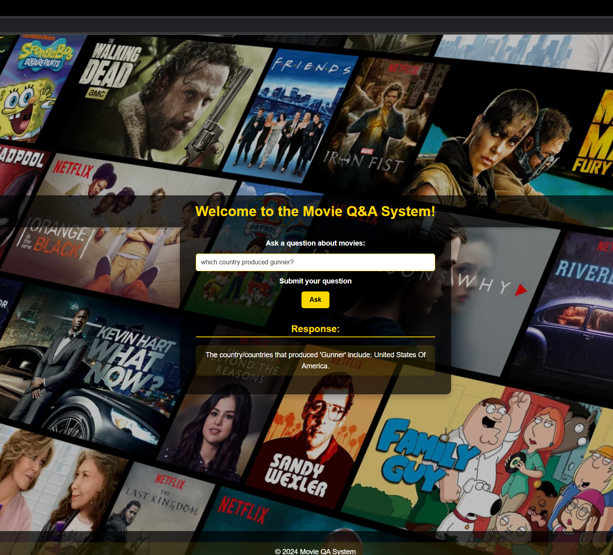
Building a user interface for QA system:
Framework Used:
Developed a Flask-based web application for seamless user interaction.
Integration:
Integrated the Q&A system to provide real-time responses to movie-related queries.
Key Feature:
Ability to ask natural language questions (e.g., "Which country produced Gunner?").

Slide 22
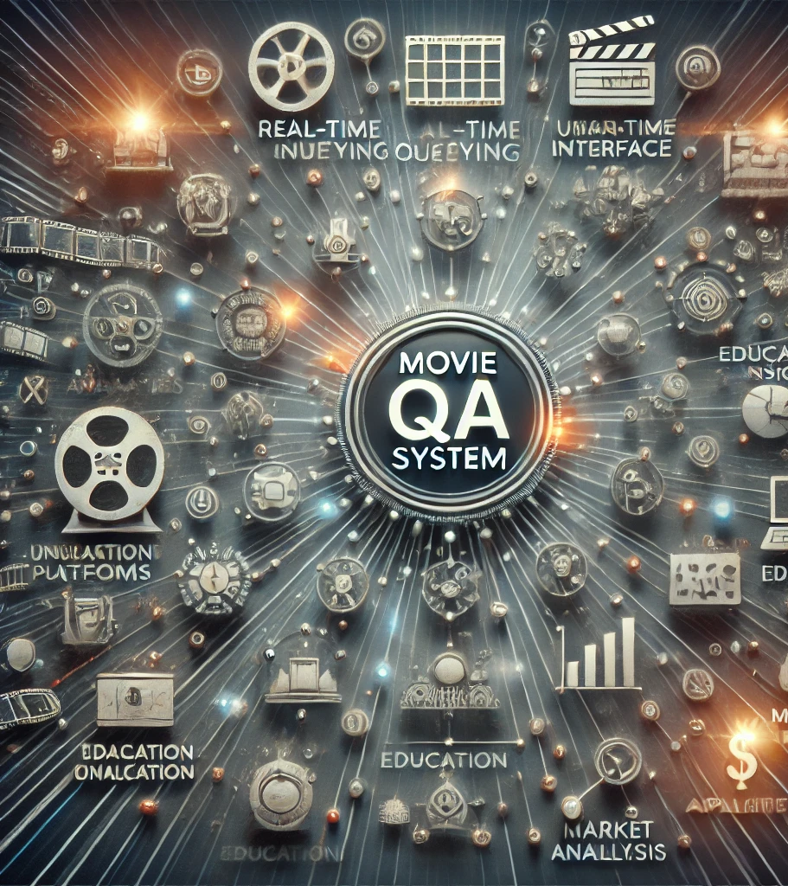
Conclusion and Project Impact:
Key Takeaways:
Successfully integrated NLP and graph databases for robust query handling.
Enhanced natural language understanding to provide accurate movie-related insights.
Demonstrated the feasibility of scaling the QA system for larger datasets.
Impact:
Potential to revolutionize data querying in the entertainment industry.
Framework applicable across other domains requiring knowledge graph-based QA systems.

